Slide 1
Getis-Ord General G
Also called high/low clustering analysis: inferential statistic.
If p-value small → statistically significant → the null hypothesis can be rejected
The higher /lower z score→ stronger/weaker the intensity of the clustering.
If rejected null hypothesis and z-score - → observed General G index is smalle→ low values are clustered in the study area.

Slide 2
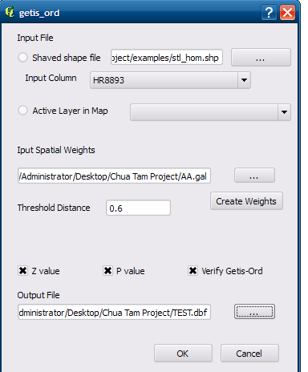
Output Sample

